Slide 1

BANK LOAN CASE STUDY

Slide 2

PROJECT DESCRIPTION
Objective:
The project focuses on performing EDA(Exploratory Data Analysis) to ensure that capable applicants are not rejected.
Dataset provided:
previous_application.csv: Contains information about previous loan applications.
application_data.csv: Provides details about the current loan applications.
columns_description.csv: Describes the columns present in the other datasets, explaining what each column represents.

Slide 3
APPROACH
Understanding the dataset provided
Cleaned the data using MS Excel
Performed all the given tasks in MS Excel
Created the presentation using MS PowerPoint
Created a video to present my presentation

Slide 4


TECH STACK USED
MS Excel (Microsoft 365 version)
Used to analyze the dataset provided to me.
MS PowerPoint (Microsoft 365 version)
Used to create and present the presentation.

Slide 5
INSIGHTS
Tasks to perform:-
Identify missing data and deal
with it appropriately
Identify outliers in the dataset
Analyze data imbalance
Perform Univariate, Segmented Univariate, and Bivariate analysis
Identify top correlations for different scenarios

Slide 6

IDENTIFY MISSING DATA AND DEAL WITH IT APPROPRIATELY

Slide 7
INSIGHTS
IDENTIFY MISSING DATA AND DEAL WITH IT APPROPRIATELY
Using the COUNTBLANK() function first I have calculated the number of blank cells in each column.
Removed all the rows which don't have SK_ID_CURR.
Adding a row that tells if there are blank rows or not(TRUE OR FALSE).
Removed all the columns whose output is FALSE.
Changing the number format of each column that contains the number.
Rows: 307511
Columns: 122
AFTER
CLEANING
Rows:
50000
Columns: 55
Before
After

Slide 8
INSIGHTS
IDENTIFY MISSING DATA AND DEAL WITH IT APPROPRIATELY
Number of missing values in each column

Slide 9
IDENTIFY OUTLIERS IN THE DATASET

Slide 10

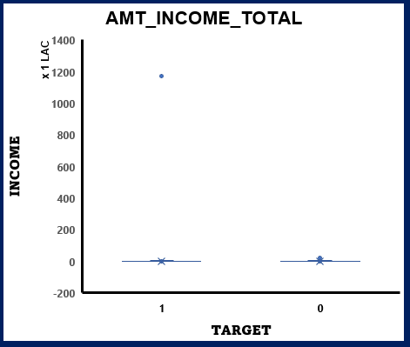
INSIGHTS
IDENTIFY OUTLIERS IN THE DATASET
Outlier
In the AMT_INCOME_TOTAL column, there is a person who has an income greater than 10cr and has payment difficulties.

Slide 11
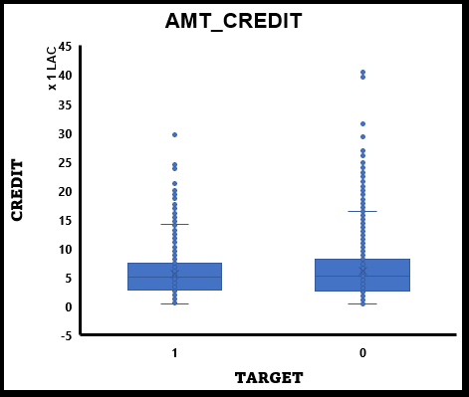
INSIGHTS
IDENTIFY OUTLIERS IN THE DATASET
Outlier
It has been observed that a considerable number of individuals have obtained loans exceeding 15 lakhs in the AMT_CREDIT column, which can be considered outliers.

Slide 12
INSIGHTS
IDENTIFY OUTLIERS IN THE DATASET
Outlier
Outlier
Certainly! In certain situations, individuals with exceptionally low incomes take out high amounts of credit, while in other cases, individuals with considerably high incomes have very low credit utilization. Both scenarios can be classified as outliers.

Slide 13
ANALYZE DATA IMBALANCE

Slide 14
INSIGHTS
ANALYZE DATA IMBALANCE
Female applicants are greater than male applicants.
The loan taken are mostly cash loans.

Slide 15
INSIGHTS
ANALYZE DATA IMBALANCE
There are 4026 applicants who are having payment difficulties.
The average credit for cash loans is 2 times greater than revolving loans.

Slide 16
INSIGHTS
ANALYZE DATA IMBALANCE
Most applications are from people who are married.
Individuals without children tend to apply for loans more frequently.

Slide 17
INSIGHTS
ANALYZE DATA IMBALANCE
Most of the applications are from working professionals.
Over 85% of applications have been submitted with only one document.

Slide 18
PERFORM UNIVARIATE, SEGMENTED UNIVARIATE AND BIVARIATE ANALYSIS

Slide 19
INSIGHTS
PERFORM UNIVARIATE, SEGMENTED UNIVARIATE, AND BIVARIATE ANALYSIS
Mean | 170767.6
Median | 145800.0
Mode | 135000.0
Mean | 599700.6
Median | 514777.5
Mode | 450000.0
Mean | 0.02080
Median | 0.01885
Mode | 0.03579
UNIVARIATE ANALYSIS

Slide 20
INSIGHTS
PERFORM UNIVARIATE, SEGMENTED UNIVARIATE, AND BIVARIATE ANALYSIS
AGE | CATEGORY | APPLICANTS
21-35 | Young Adult | 14440
36-60 | Adult | 30296
> 60 | Senior | 5263
SEGMENTED UNIVARIATE ANALYSIS

Slide 21
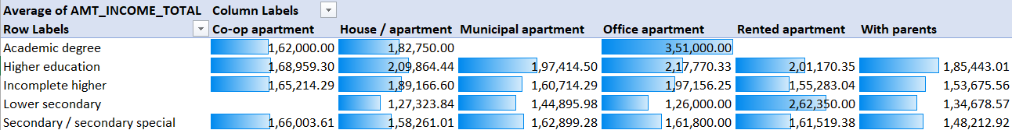
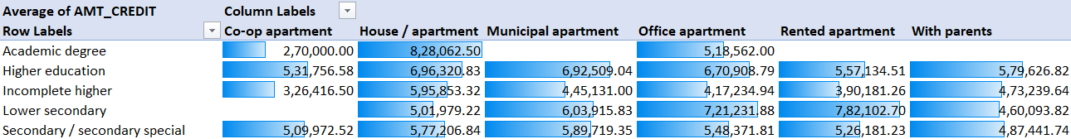
INSIGHTS
PERFORM UNIVARIATE, SEGMENTED UNIVARIATE, AND BIVARIATE ANALYSIS
Individuals residing in office apartments and possessing an academic degree enjoy the highest income levels.
Individuals residing in house or apartment and possessing an academic degree takes high credit.
BIVARIATE ANALYSIS

Slide 22
IDENTIFY TOP CORRELATION FOR DIFFERENT SCENARIOS

Slide 23
INSIGHTS
IDENTIFY TOP CORRELATIONS FOR DIFFERENT SCENARIOS
1 | REGION_RATING_CLIENT | REGION_RATING_CLIENT_W_CITY
2 | DAYS_BIRTH | FLAG_EMP_PHONE
3 | FLAG_WORK_PHONE | FLAG_PHONE
TOP 3 CORRELATIONS
CORRELATIONS FOR TARGET 1( DEFAULT )

Slide 24
INSIGHTS
IDENTIFY TOP CORRELATIONS FOR DIFFERENT SCENARIOS
1 | REGION_RATING_CLIENT | REGION_RATING_CLIENT_W_CITY
2 | DAYS_BIRTH | FLAG_EMP_PHONE
3 | AMT_INCOME_TOTAL | AMT_CREDIT
TOP 3 CORRELATIONS
CORRELATIONS FOR TARGET 0( ALL OTHER CASES )

Slide 25
Thank you
EXCEL LINK: click here
VIDEO LINK: click here

